Slide 1

Module 12 – SMA-X Human Resources
Jan 2018
Notes:
The next module that we will cover in our course will be SMA-X Human Recourses application
This module is one of the modules that extends SMA-X presence out of only IT department. Human resources requests could be significantly different from IT related requests, so we have separate process workflow for HR related requests.

Slide 2
Objectives
After completing this module, you should be able to:
Describe the features of the SMA-X Human Resource application
Understand the HR application workflow, requests and articles
Notes:
Additionally we will have brief overview of Out of the box content for HR request in SMA-X

Slide 3
Human Resources Application

Slide 4
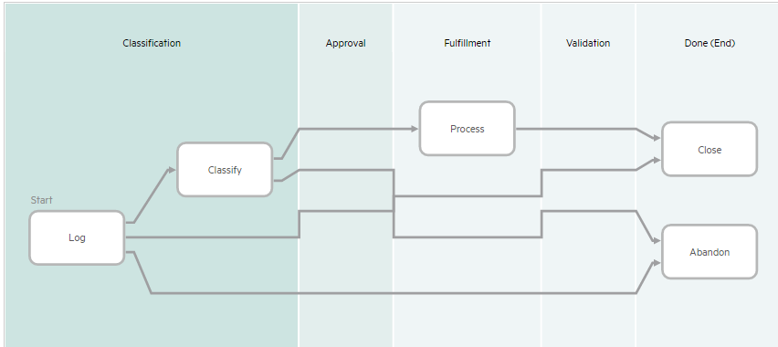
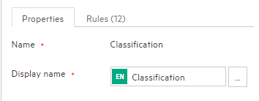
Human Resource Application
HR Support Request
Configured and managed separately from IT support request process
Streamlined process with no approval or validation (use current IT Service Request for offerings requiring approval)
Editable Meta phase “Display” name*
Configure end user facing display name
Also applies to IT Support and IT Service processes
* applies to all processes, not just the HR support workflow
Notes:
HR different from IT in their nomenclature, overall duration (medical leave could be a 6 year E2E), etc. so created a separate module or application
Benefits of having separate process:
Many customers adding HR processes to the IT implementation
Often process are related to IT – for example on/offboarding bundle includes HR, IT and other departments – but customers also doing HR only for example: policy questions, pay or HR support
Very simplified process designed to support simple queries not requiring approval or validation. So basically users ask a HR related question service desk reply them. Just simple Q&A to the HR organization. If validation or approval are required then using IT service request is required
Also, this module allows you do edit display name, allowing you to better match to HR terms and be more intuitive for end-user
Note: name change should not re-purpose the meta phase meaning to avoid unintended consequences (e.g. OOTB metrics no longer make sense)

Slide 5
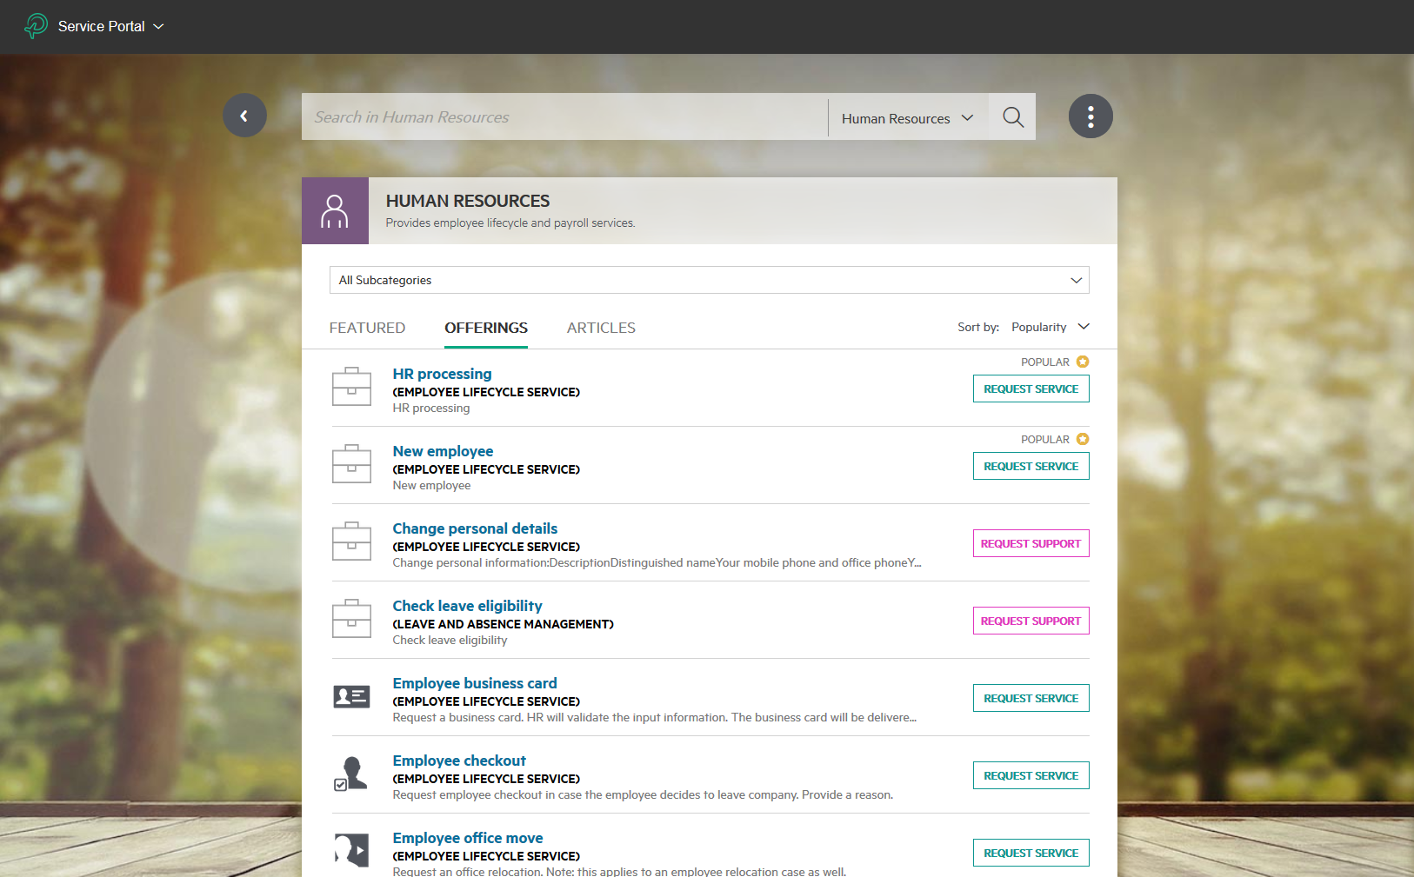
Human resources in Self Service
Can access directly to most popular HR offerings
Look through KM articles dedicated to HR
Notes:
Lets have a look what end user have for HR support request in Self-service portal. Out of the box we have content for HR services and offerings, end-user should choose one of them to create HR related request. Basically it is only way to create HR Support request.
Also end-users can look through KM articles related to HR. We have some out of the box KM articles for demo purposes.

Slide 6
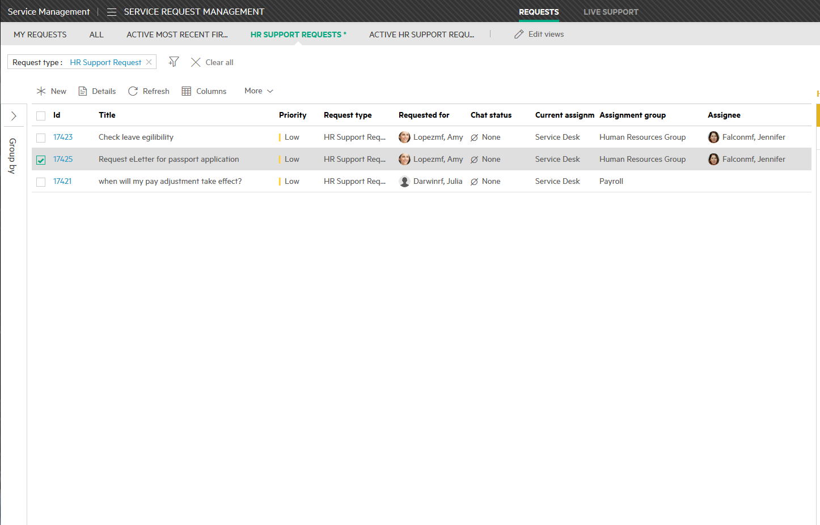
Human resources in Agent Interface
Service request created with Catalogue offerings related to HR
Several services and offerings available OOTB
Using separate from IT request HR Request workflow
Question-answer based

Slide 7
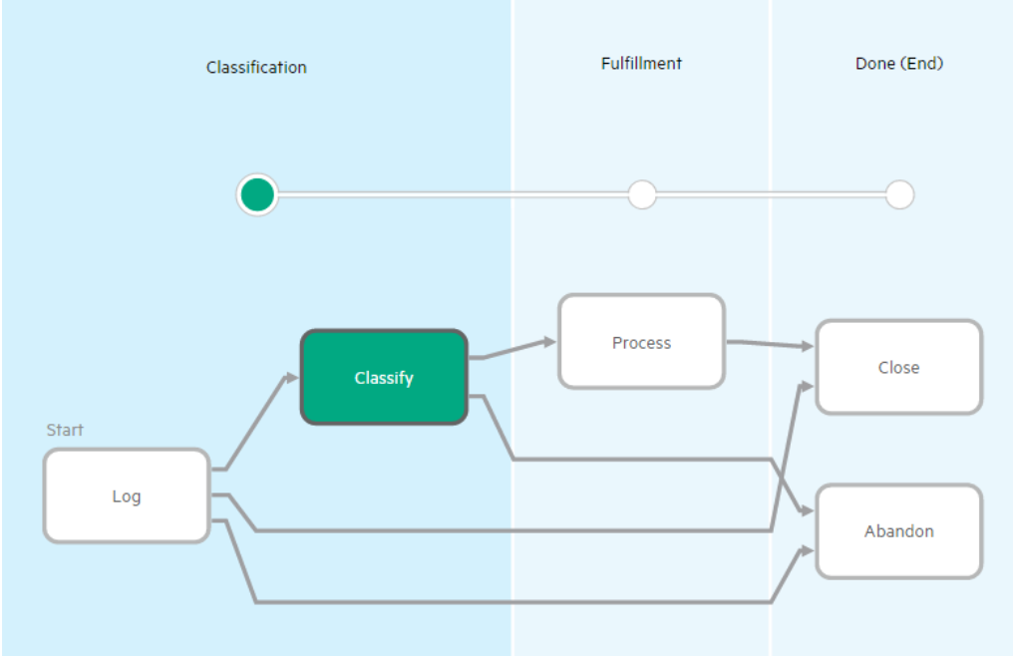
HR support request workflow
Requested information is provided
Transits automatically to classify in most cases
Notes:
As you can see workflow for HR support request is pretty simple. No validations, no approvals included.
Workflow starts from logging phase – that’s the phase where user asks his question to HR organization. In most of the times it will be transited automatically to classify stage, because user already picked service that he needs . Then it goes to fulfillment phase when one of the agents start to work on the request. When solution-answer is provided, agent closes request and no validation from user required

Slide 8
HR Application usage
Out-of-the-box behavior
The only way to create an HR Support request is to select an HR Support offering.
When creating a request in ESS, selecting the highest urgency (with single user impact), will result in a Medium priority.
The only way for the agent to get a High or Critical priority is to select impact values such as Multiple users, Site or department, or Enterprise.
Since we are using a mix of HR Support requests and IT Service requests (when approvals are required) for HR, reporting can be challenging requiring filtering by service or assignment group.

Slide 9
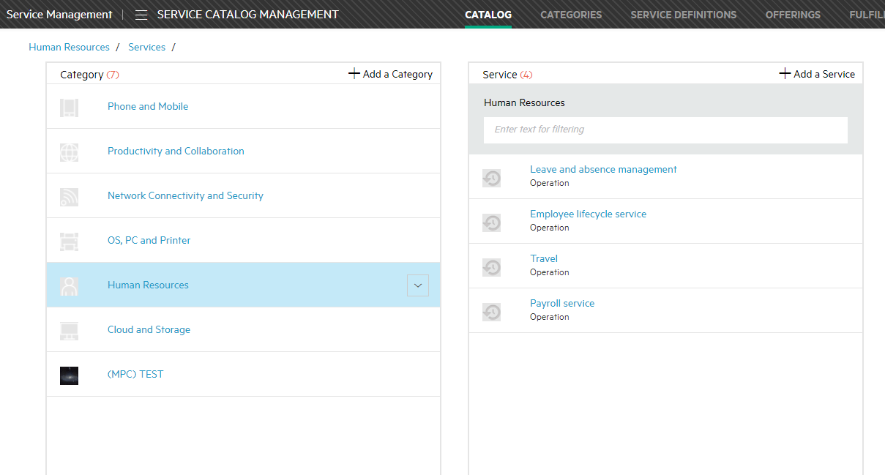
Human Resources Catalog
Categories and Service Definitions in sample data
Notes:
We have a category in the catalogue named Human Resources and we have service definitions for things like travel, payroll service, leave and absence management and employee lifecycle service. Of course this is configurable through standard adding of business service

Slide 10
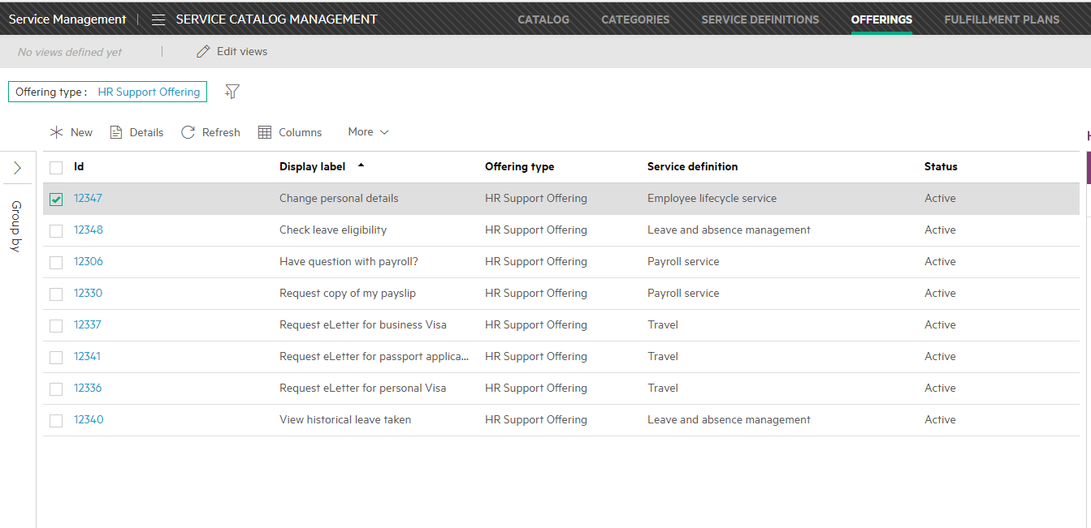
Human Resources Catalog
HR Support Offerings in sample data
Notes:
And below out of the box service definitions we have this offerings

Slide 11
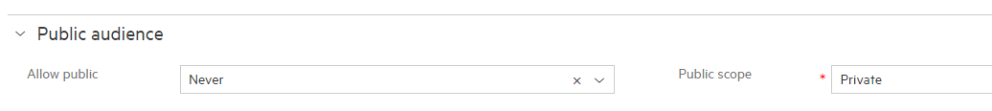
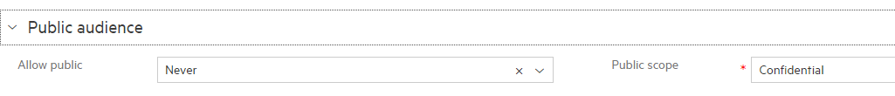
Private and Confidential Requests
Private Requests (configured on offering)
Seen by requestor and requested for persons only in ESS
Confidential Requests (configured on offering)
Seen by the requested by person but not by the requested for person.
For example, an HR request for demotion or dismissal of an employee may be seen by the manager requesting it, but not by the “requested for” employee.
Note: A user can create a request, and add other users as followers, without having to make the request a public request.
Notes:
The other thing that we will point out is that some of request are configured as private, some of them are configured as confidential. Private basically tells us that it’s seen only by requestor, the requested by and requested for people in ess. Its not able to be followed by other people or shared with other people. Now the confidential request are seen by the requested by person but not by the requested for person.

Slide 12
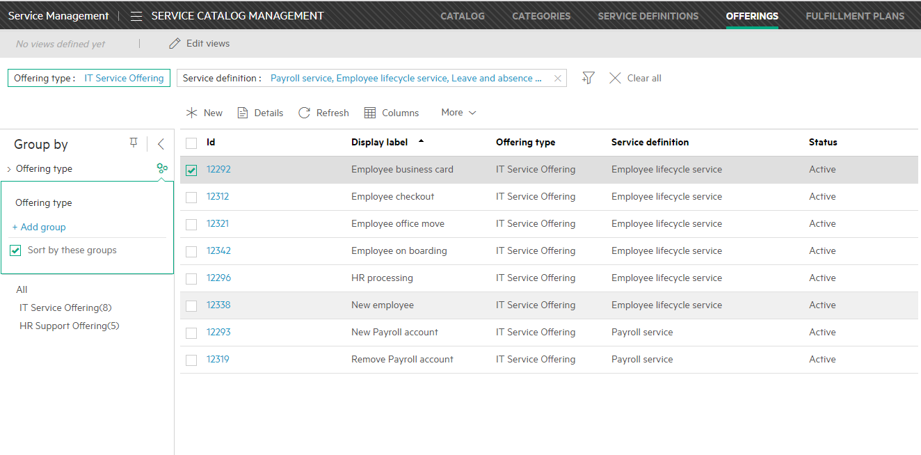
Human Resource Catalog
IT Service Offerings for Human Resources Service Definitions
Notes:
Now for some of the service offerings that requires approvals it is configured to use IT service request process.

Slide 13
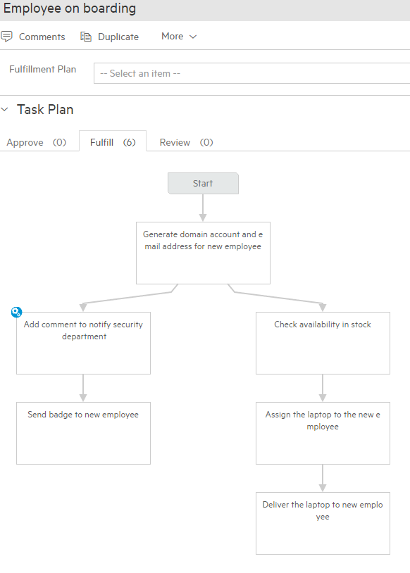
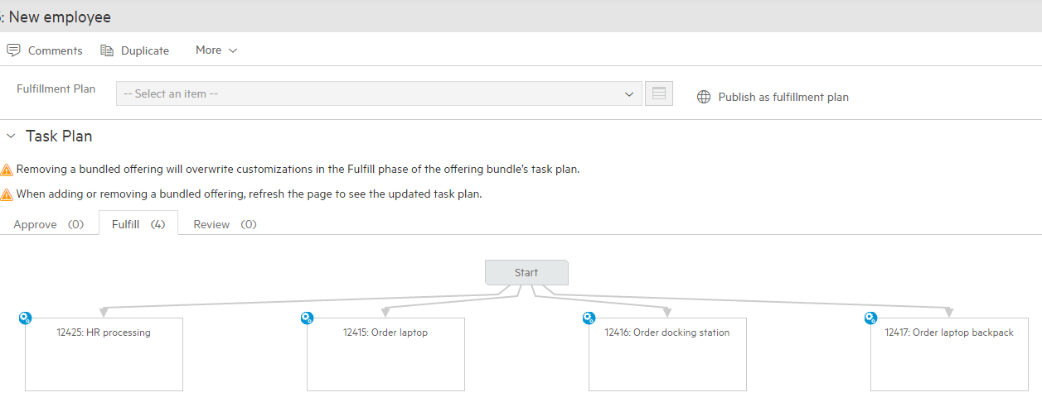
New Employee offerings
“Employee on boarding” has Stock reservation
“New Employee” is a bundled offering

Slide 14
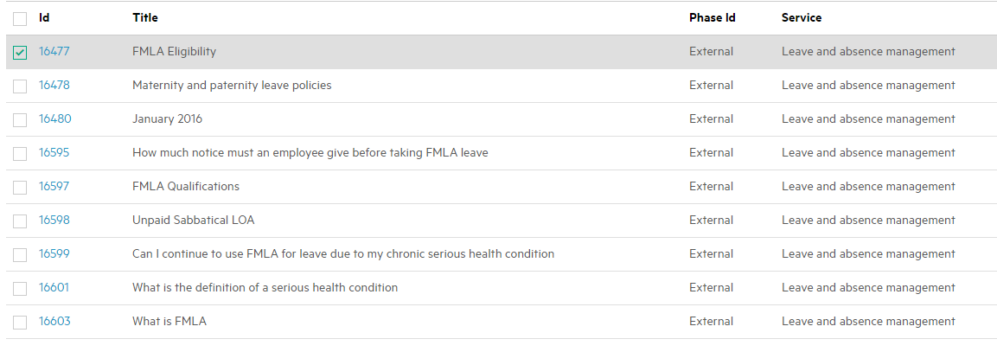
Human Resources KM Articles

Slide 15
Additional configuration for the HR application
In addition to the normal configuration (custom fields, forms, process, reports, rules, catalog offerings),
customers may want to configure the HR application with:
Impact and Urgency values that make sense for HR and result in desired priority values
Category values for Request, Incident, etc. records relevant to HR requests
(OOB categories are: Access, Cloud, Communication & Collaboration, Facilities, Fault, Hardware, Network, Personal Systems, Performance, Security, Software)
Data Domain for record separation
Hidden or Encrypted fields for private information (employee id, social security number, salary, etc)

